Slide 1
Welcome to AP Histories: World and US

Slide 2
Class Basics
Your student should have brought home a syllabus for you to review and sign, the digital copy is on the school web page
Content
Grading
Calendar
Late Work
Academic Honesty
Communication

Slide 3
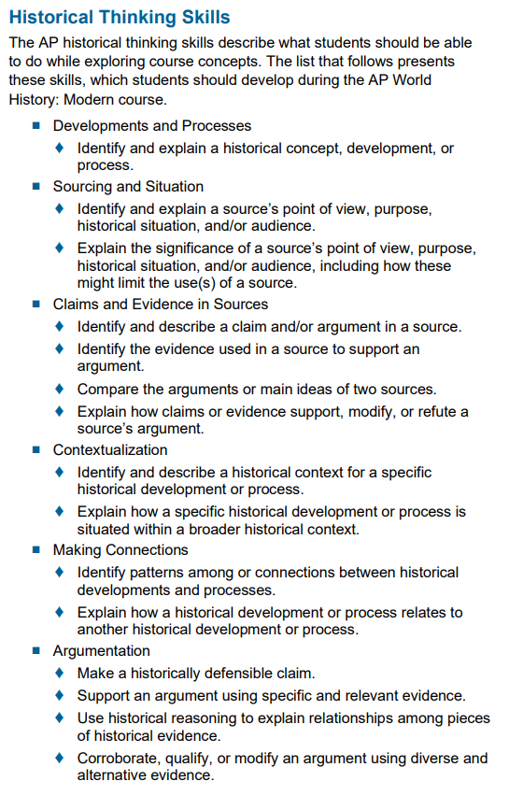
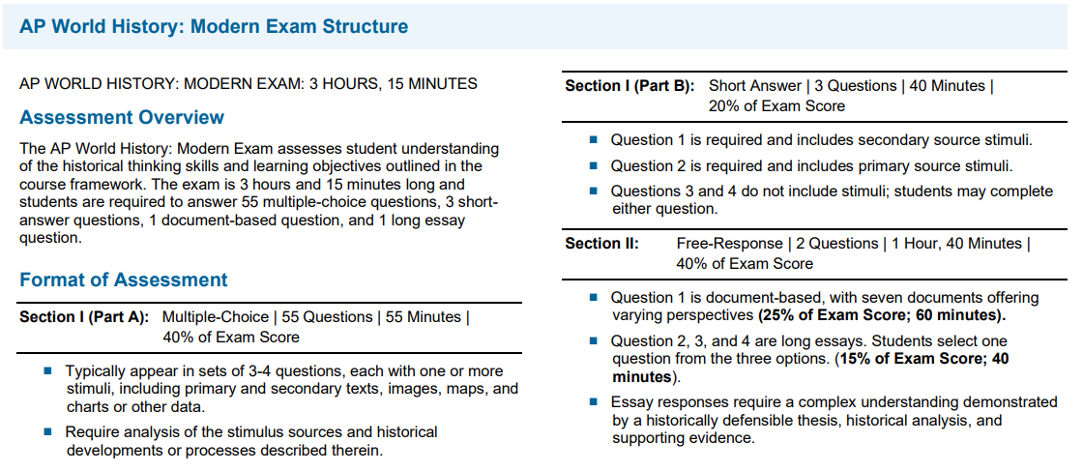
Course Overview https://apcentral.collegeboard.org/pdf/ap-world-history-modern-course-overview.pdf?course=ap-world-history-modern

Slide 4
Writing & Analysis Skills
SAQ: Short Answer Question (close to FRQs from Human Geo)
Address Prompt/Answer Question
Cite Specific Evidence
Explain how evidence resolves/supports argument made at the beginning
DBQ: Document-based Question
Constructing arguments using documents as evidence
Analyzing the historical context in which your argument is situated
Analyzing Author purpose/pov
Supplying extended outside information that supplements the argument
LEQ: Long Essay Question
Utilizes the Historical Thinking Skills (comparison, causation, change/continuity)
Provides no outside reference, all content comes from student

Slide 5
Potential Struggles
Usual
Buying into/internalizing writing strategies
Knowing what to prioritize in notes/review
Big Picture/Context
Have a gradual approach, easily overwhelmed
Proactive Planning
It’s NOT creative writing
Post-Covid
Not being able to google/thinking independently
Struggling to activate peers as learning partners in addition to social opportunities
Attention span/urge to disconnect
Difficulty asking for help in person

Slide 6
Common Questions
Where is my student’s book?
Majority of the time will use the district-purchased book that is online/in Canvas, we will occasionally supplement with other texts for which we have a class set
What’s the best way to reach you?
Student: Email or Teams, Parent: Email kdavis12@houstonisd.org I always respond within 24 hours, usually faster, if you don’t hear from me it’s possible the district has blocked, please try reaching out with a different email or having student pass it on ☺
When are tutorials?
Students can get a pass for tutorials for any advocacy not engaged in school-wide activities, additionally students can come by during lunch on most days, preferred to let me know they’re coming if possible. A club schedule is posted on my door so that kids can see when the room is full.
Why does my student have hours of reading at night?
Students have a minimum of a week to read a chapter, they are usually 35 pages, that’s 5 pages a day. Students should be not starting notes at 2am the morning they’re due ☹
We do not assign homework outside of reading, reading/note-taking is their homework and is essential to class

